Slide 1
South African Joint AP/MTT/EMC Chapter 2016 Feedback
Vice-Chair EMC
Dr Gideon Wiid
Stellenbosch University
wiidg@sun.ac.za

Slide 2
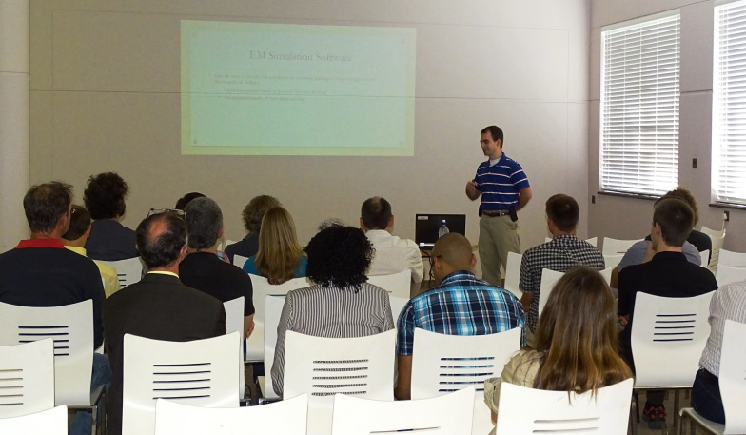
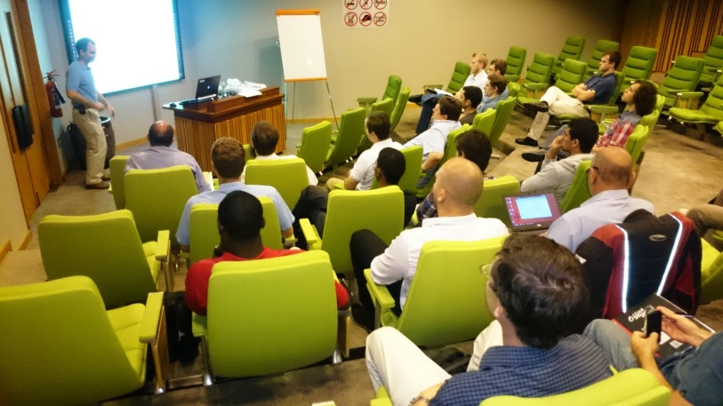
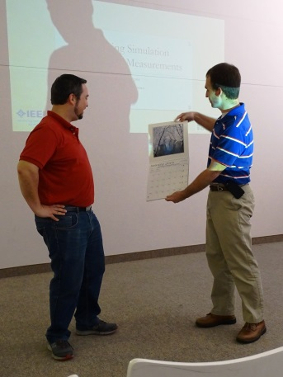
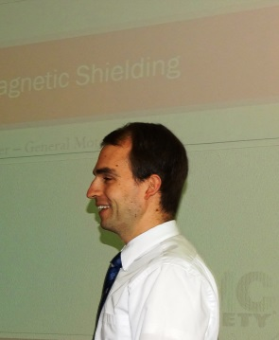
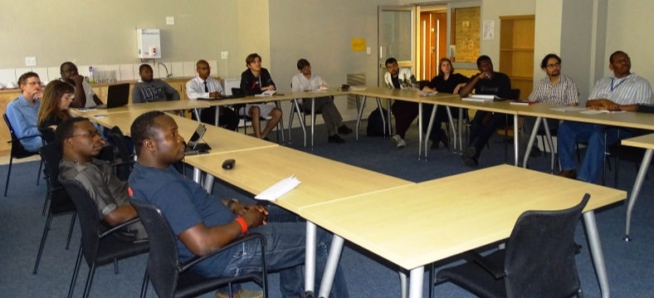
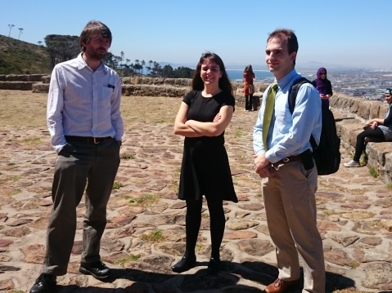
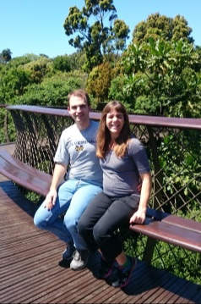
DL visit by Scott Piper, General Motors
Scott Piper gave four lecturesd on EMC and modelling topics, two at Stellenbosch University, the other two at University of Pretoria. And University of Cape Town. They were very well received with about 20 attendees at each session. Scott and his wife Condy also enjoyed the

Slide 3
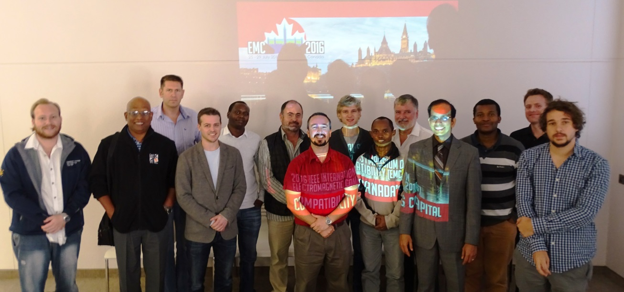
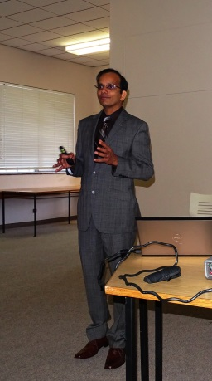
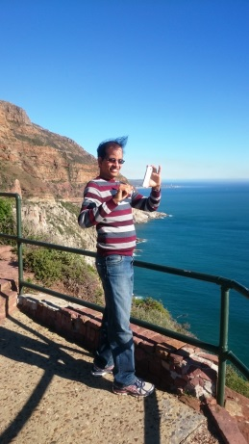
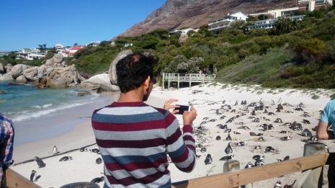
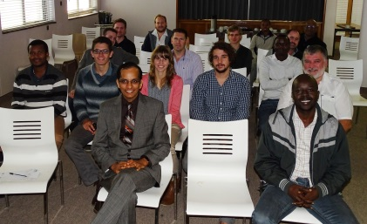
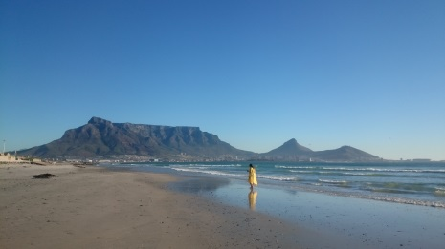
DL visit by Prof Ram Achar, Carleton University
Prof Ram Achar gave two lectures on “Demystifiying Signal Integrity in High Speed Designs” one at Stellenbosch University, the other at University of Pretoria. They were very well received with about 15 attendees at each session. Ram also enjoyed the scenery driving around the Cape Peninsula and visiting Boulders Penguin breeding colony, Chapman’s Peak Drive, and a beautiful view of Table Mountain.

Slide 4
Summary
Scott visit to RSA required to US$1000 co-fund
Ram visited two consecutive countries for better DL funding - Croatia and RSA
Other European Countries wishing to join RSA or other Region 8 countries in “double-visit” to make it more affordable
Welcome to contact wiidg@sun.ac.za
RSA Joint Chapter on AP/MTT/EMC two-yearly Conference on 28 and 29 July
Website link at
http://www.ee.sun.ac.za/south-african-ieee-joint-apmttemc-chapter-conference-2016/

